Slide 1
MCP
Model Context Protocol

Slide 2
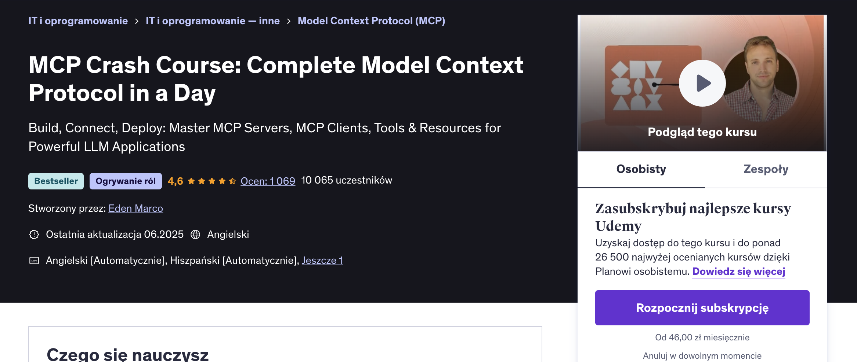

Slide 3
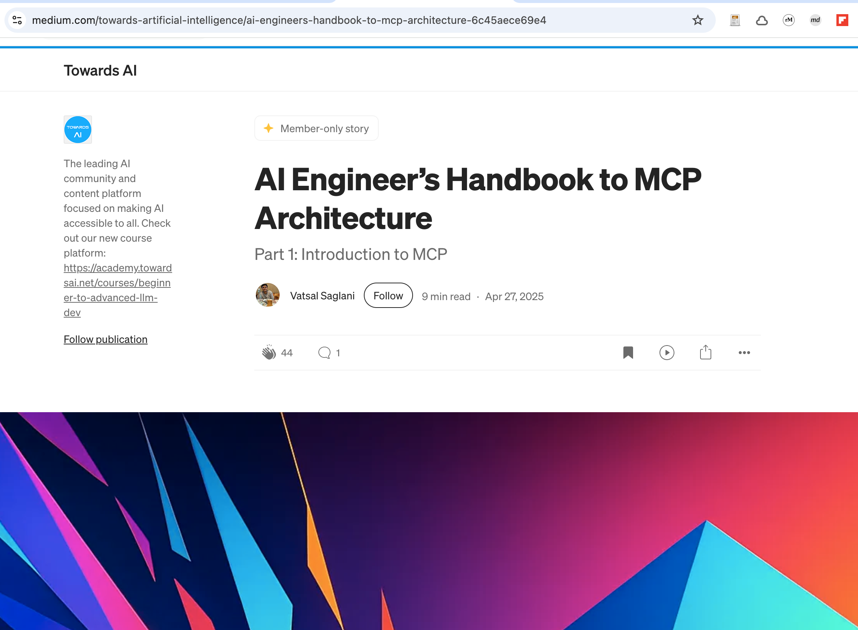

Slide 4

Problem
<code_2>
<code_1>
<code_3>

Slide 5
Theorem
In software engineering
you can solve any problem
by adding an extra layer of abstraction

Slide 6
Solution
<code_2>
<code_1>
<code_3>

Slide 7
Model Context Protocol

Slide 8
<GPT-4o>
<Claude 4.0 Sonnet>
<Gemini 2.5 Pro>

Slide 9
<GPT-4o>
<Claude 4.0 Sonnet>
<Gemini 2.5 Pro>

Slide 10

Server 1
Server 2
Host
Client
Server 3

Slide 11
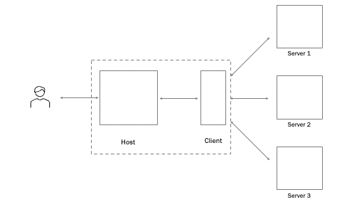
Process

Slide 12
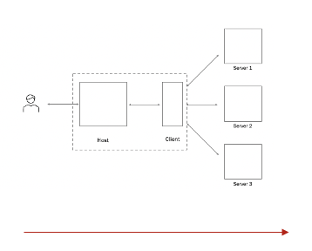
Process
User: makes a request through the host application
LLM: processes the request > looks for corresponding MCP tools
Client: if tool exists, packages the request > forwards using MCP to the MCP Server
Server: receives the request > triggers appropriate action @tool > processes its response > sends back to Client
Client: sends the response to the LLM
LLM: takes the response > integrates into natural language response > sends to the user via the host application

Slide 13
Communication

Slide 14
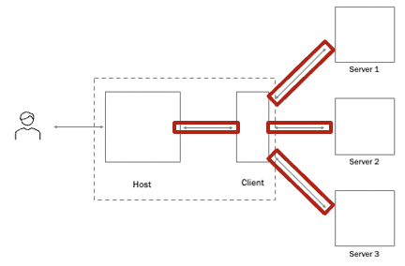
Information
Structured formatting (XML)
Information hierarchies/prioritization
Metadata Tagging
Process instructions

Slide 15
Host

Slide 16
Host
Host runs AI model - User asks a question Host delegates to client - "I need to get weather data"
Client connects to server - Finds appropriate MCP server Client invokes tools/resources - Gets the weather data
Client returns results - Passes data back to host Host uses results - AI model incorporates data into response

Slide 17
Host
Client is subordinate to host - The host controls when and how MCP is used Client is the bridge - Handles all the technical MCP communication Host makes decisions - Determines which servers to connect to and when to use them Separation of concerns - Host focuses on AI, client focuses on connectivity

Slide 18
Client

Slide 19
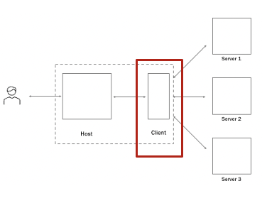
Client
Expose Tools
Expose Resources
Expose Prompts
<communicate>
<communicate>
Invoke Tools
Query for Resources
Interpolate Prompts

Slide 20
Server

Slide 21
allow the AI to perform specific tasks Retrieve/search, Send Message, Update DB..
Model-controlled
Functions invoked by the model
@tool
read-only data sources that provide structured information to LLM, static or dynamic Files, DB Records, API responses
Application-controlled
Data exposed to the application
@resource
{interfaces}
reusable templates that help the LLM carry out structured tasks consistently Documentation Q&A, Transcript Summary, Output as JSON
User-controlled
Pre-defined templates for AI interactions
@prompt
Server

Slide 22
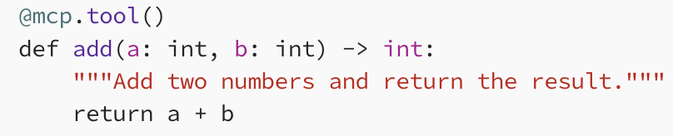
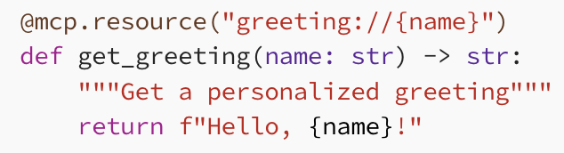
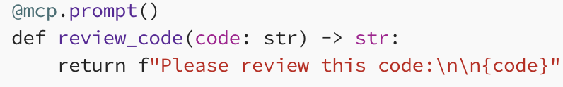
allow the AI to perform specific tasks Retrieve/search, Send Message, Update DB..
@tool
read-only data sources that provide structured information to LLM Files, DB Records, API responses
@resource
reusable templates that help the LLM carry out structured tasks consistently Documentation Q&A, Transcript Summary, Output as JSON
@prompt
Server

Slide 23
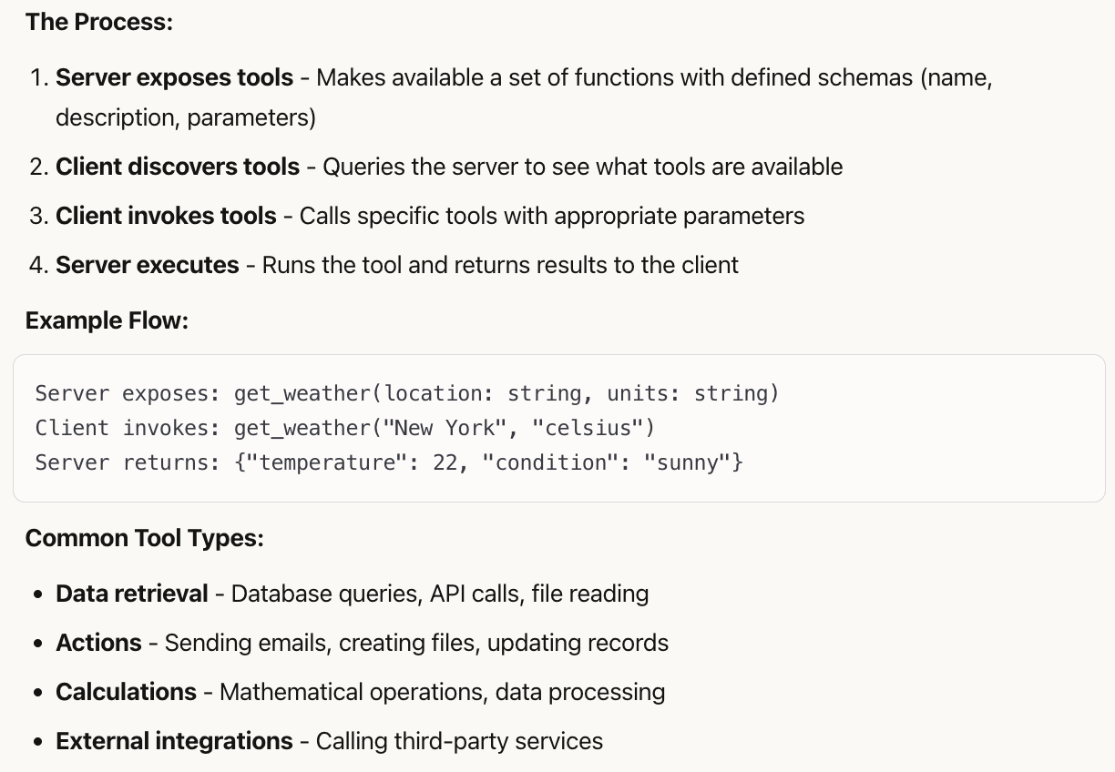
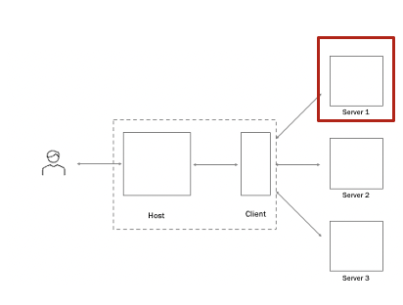
@tool

Slide 24
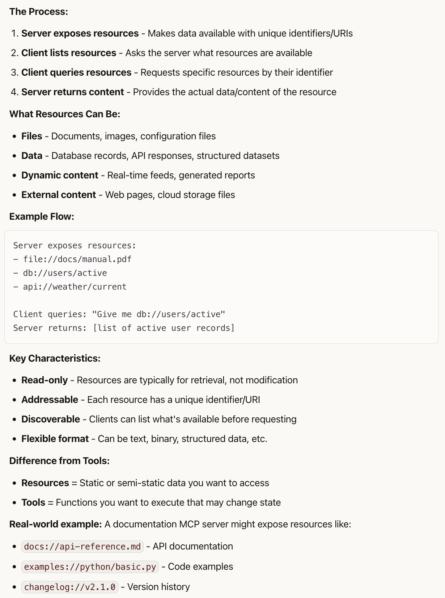
@resource

Slide 25
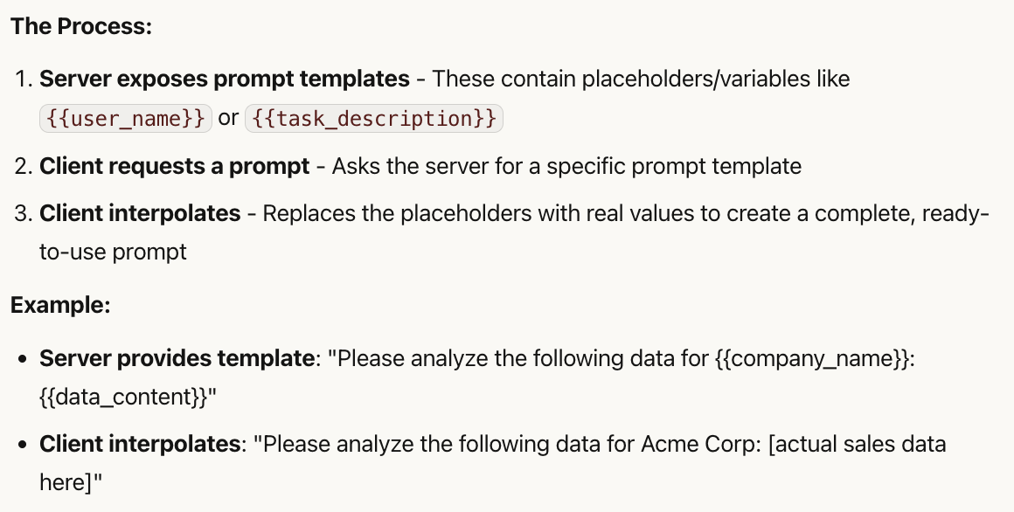
@prompt

Slide 26
How to create the MCP server?

Slide 27
From scratch
< …\>

Slide 28
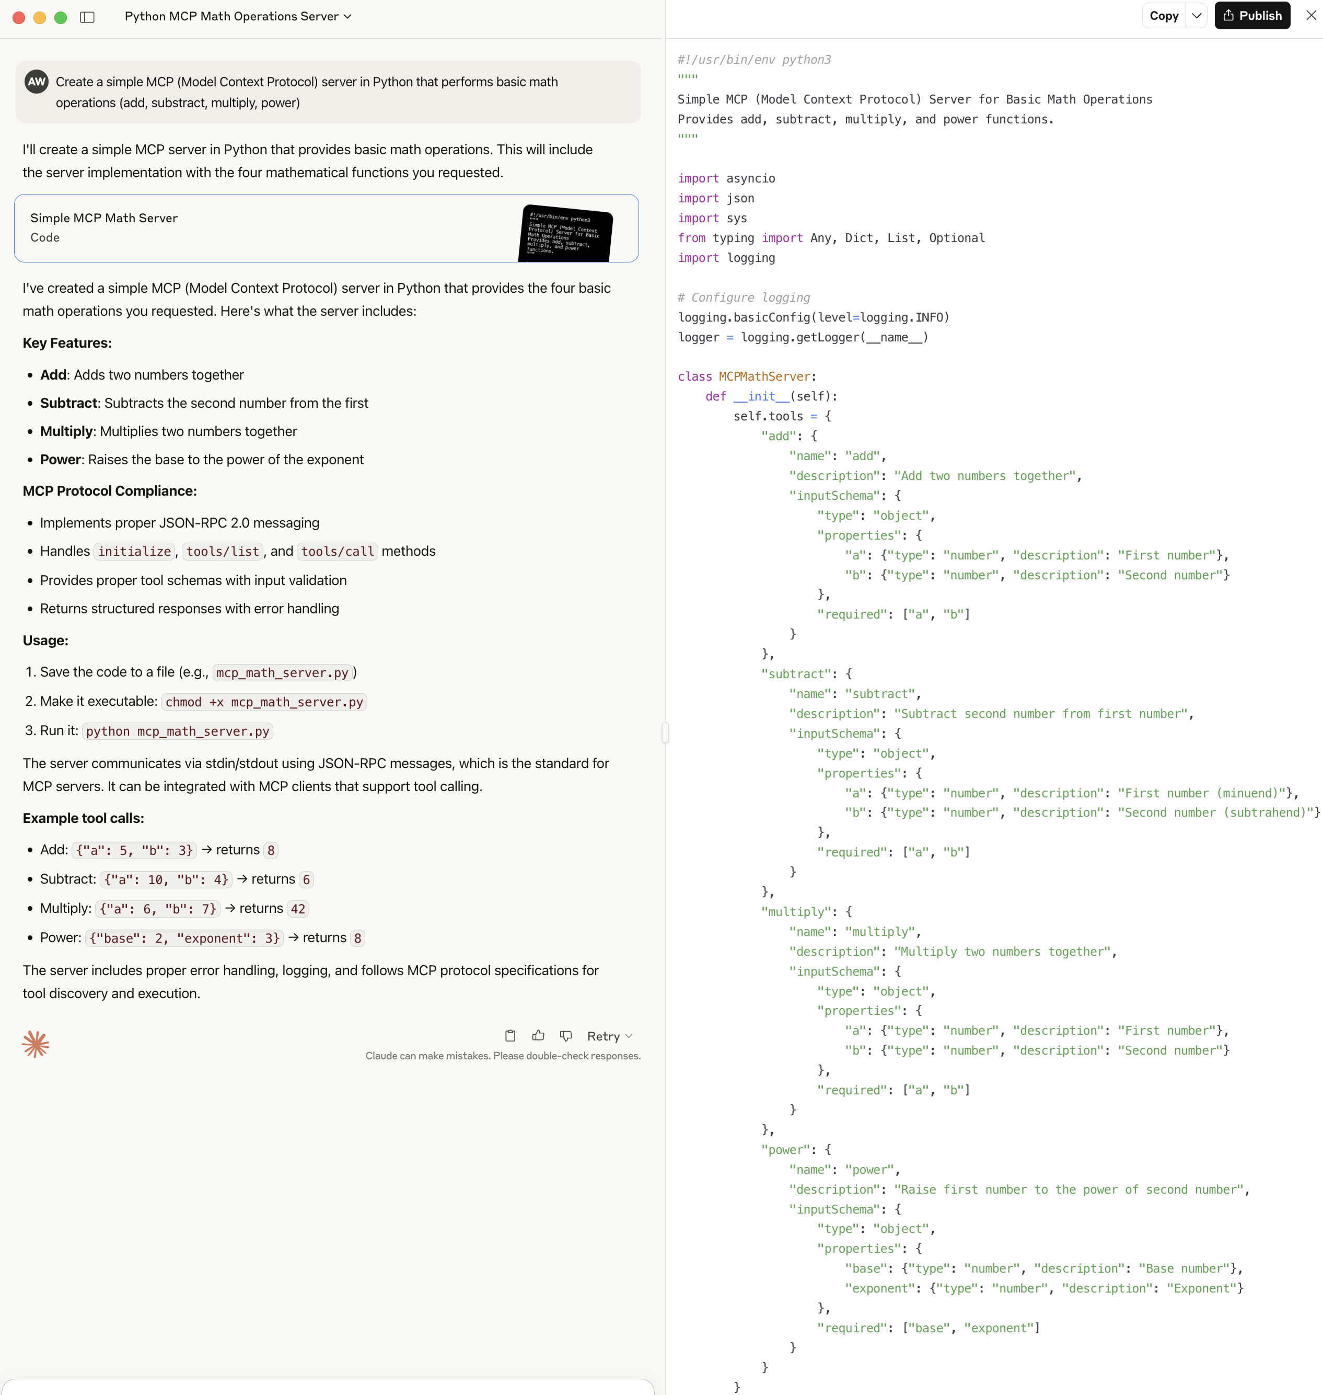
Ask LLM

Slide 29
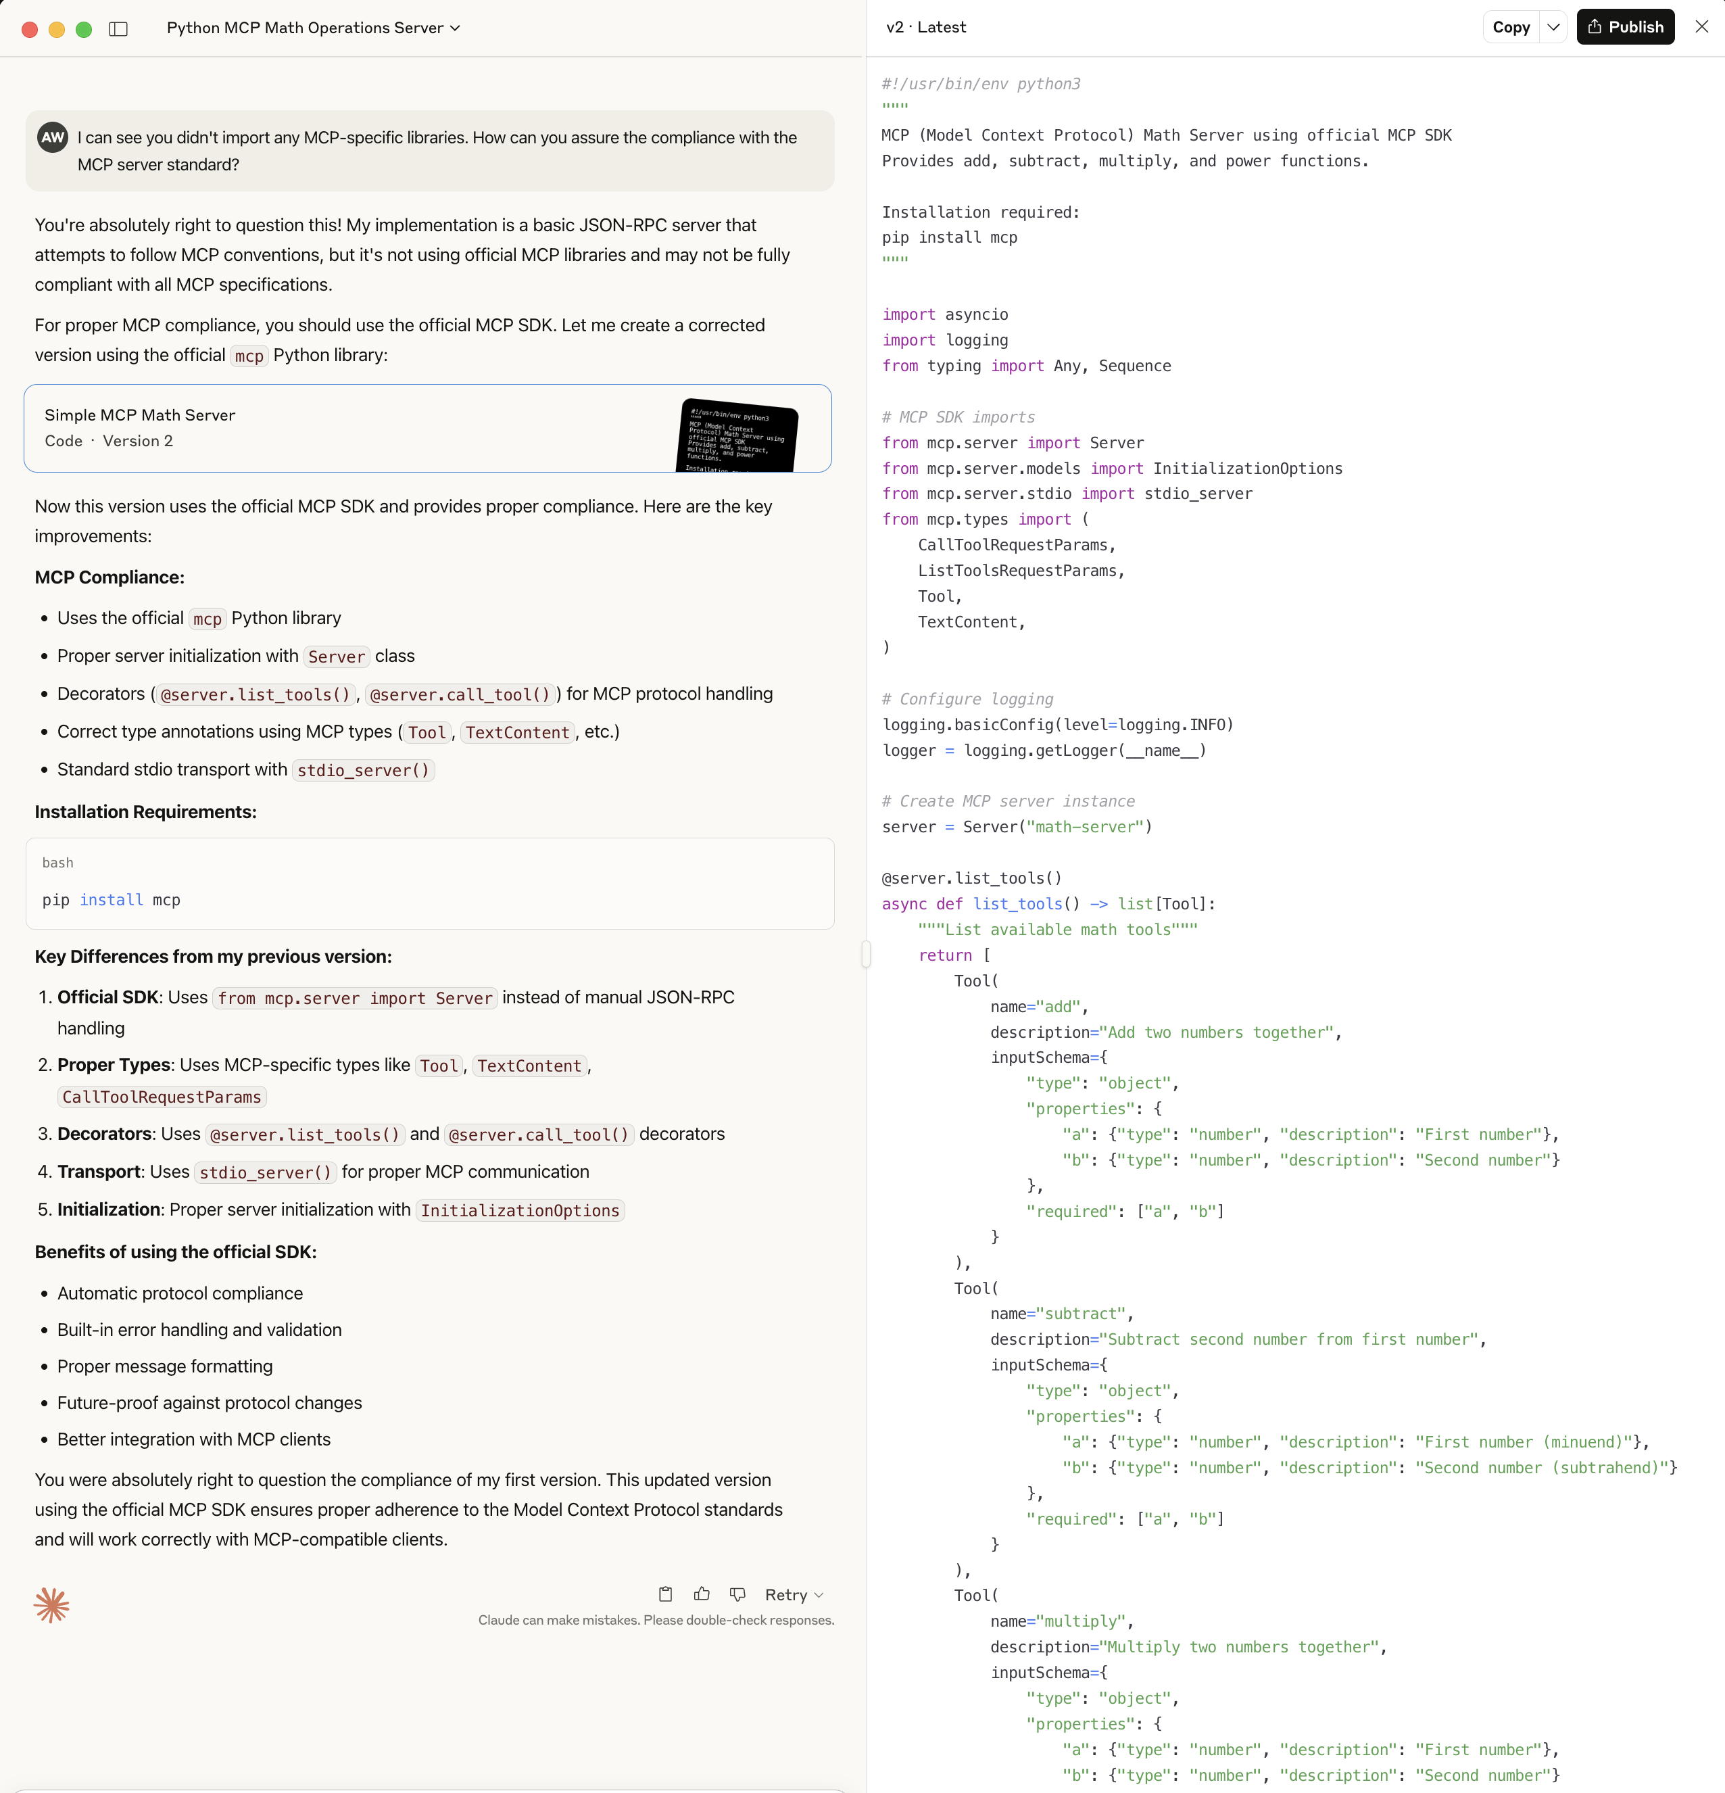
Ask LLM

Slide 30
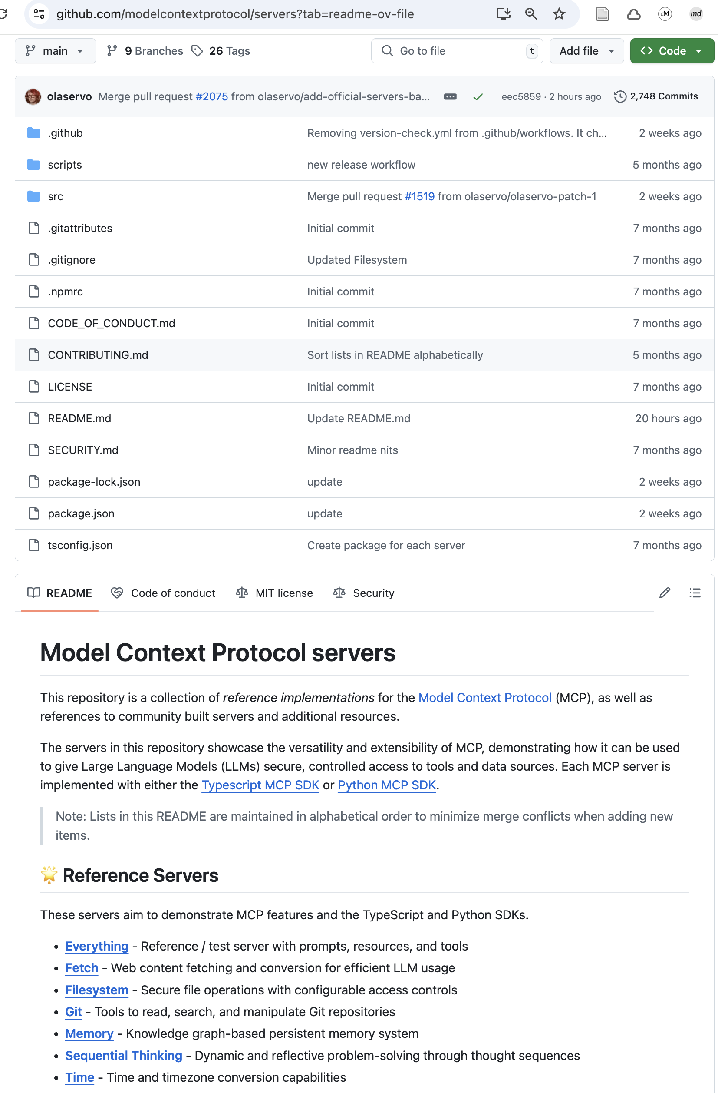
Basing on official MCP SDK

Slide 31
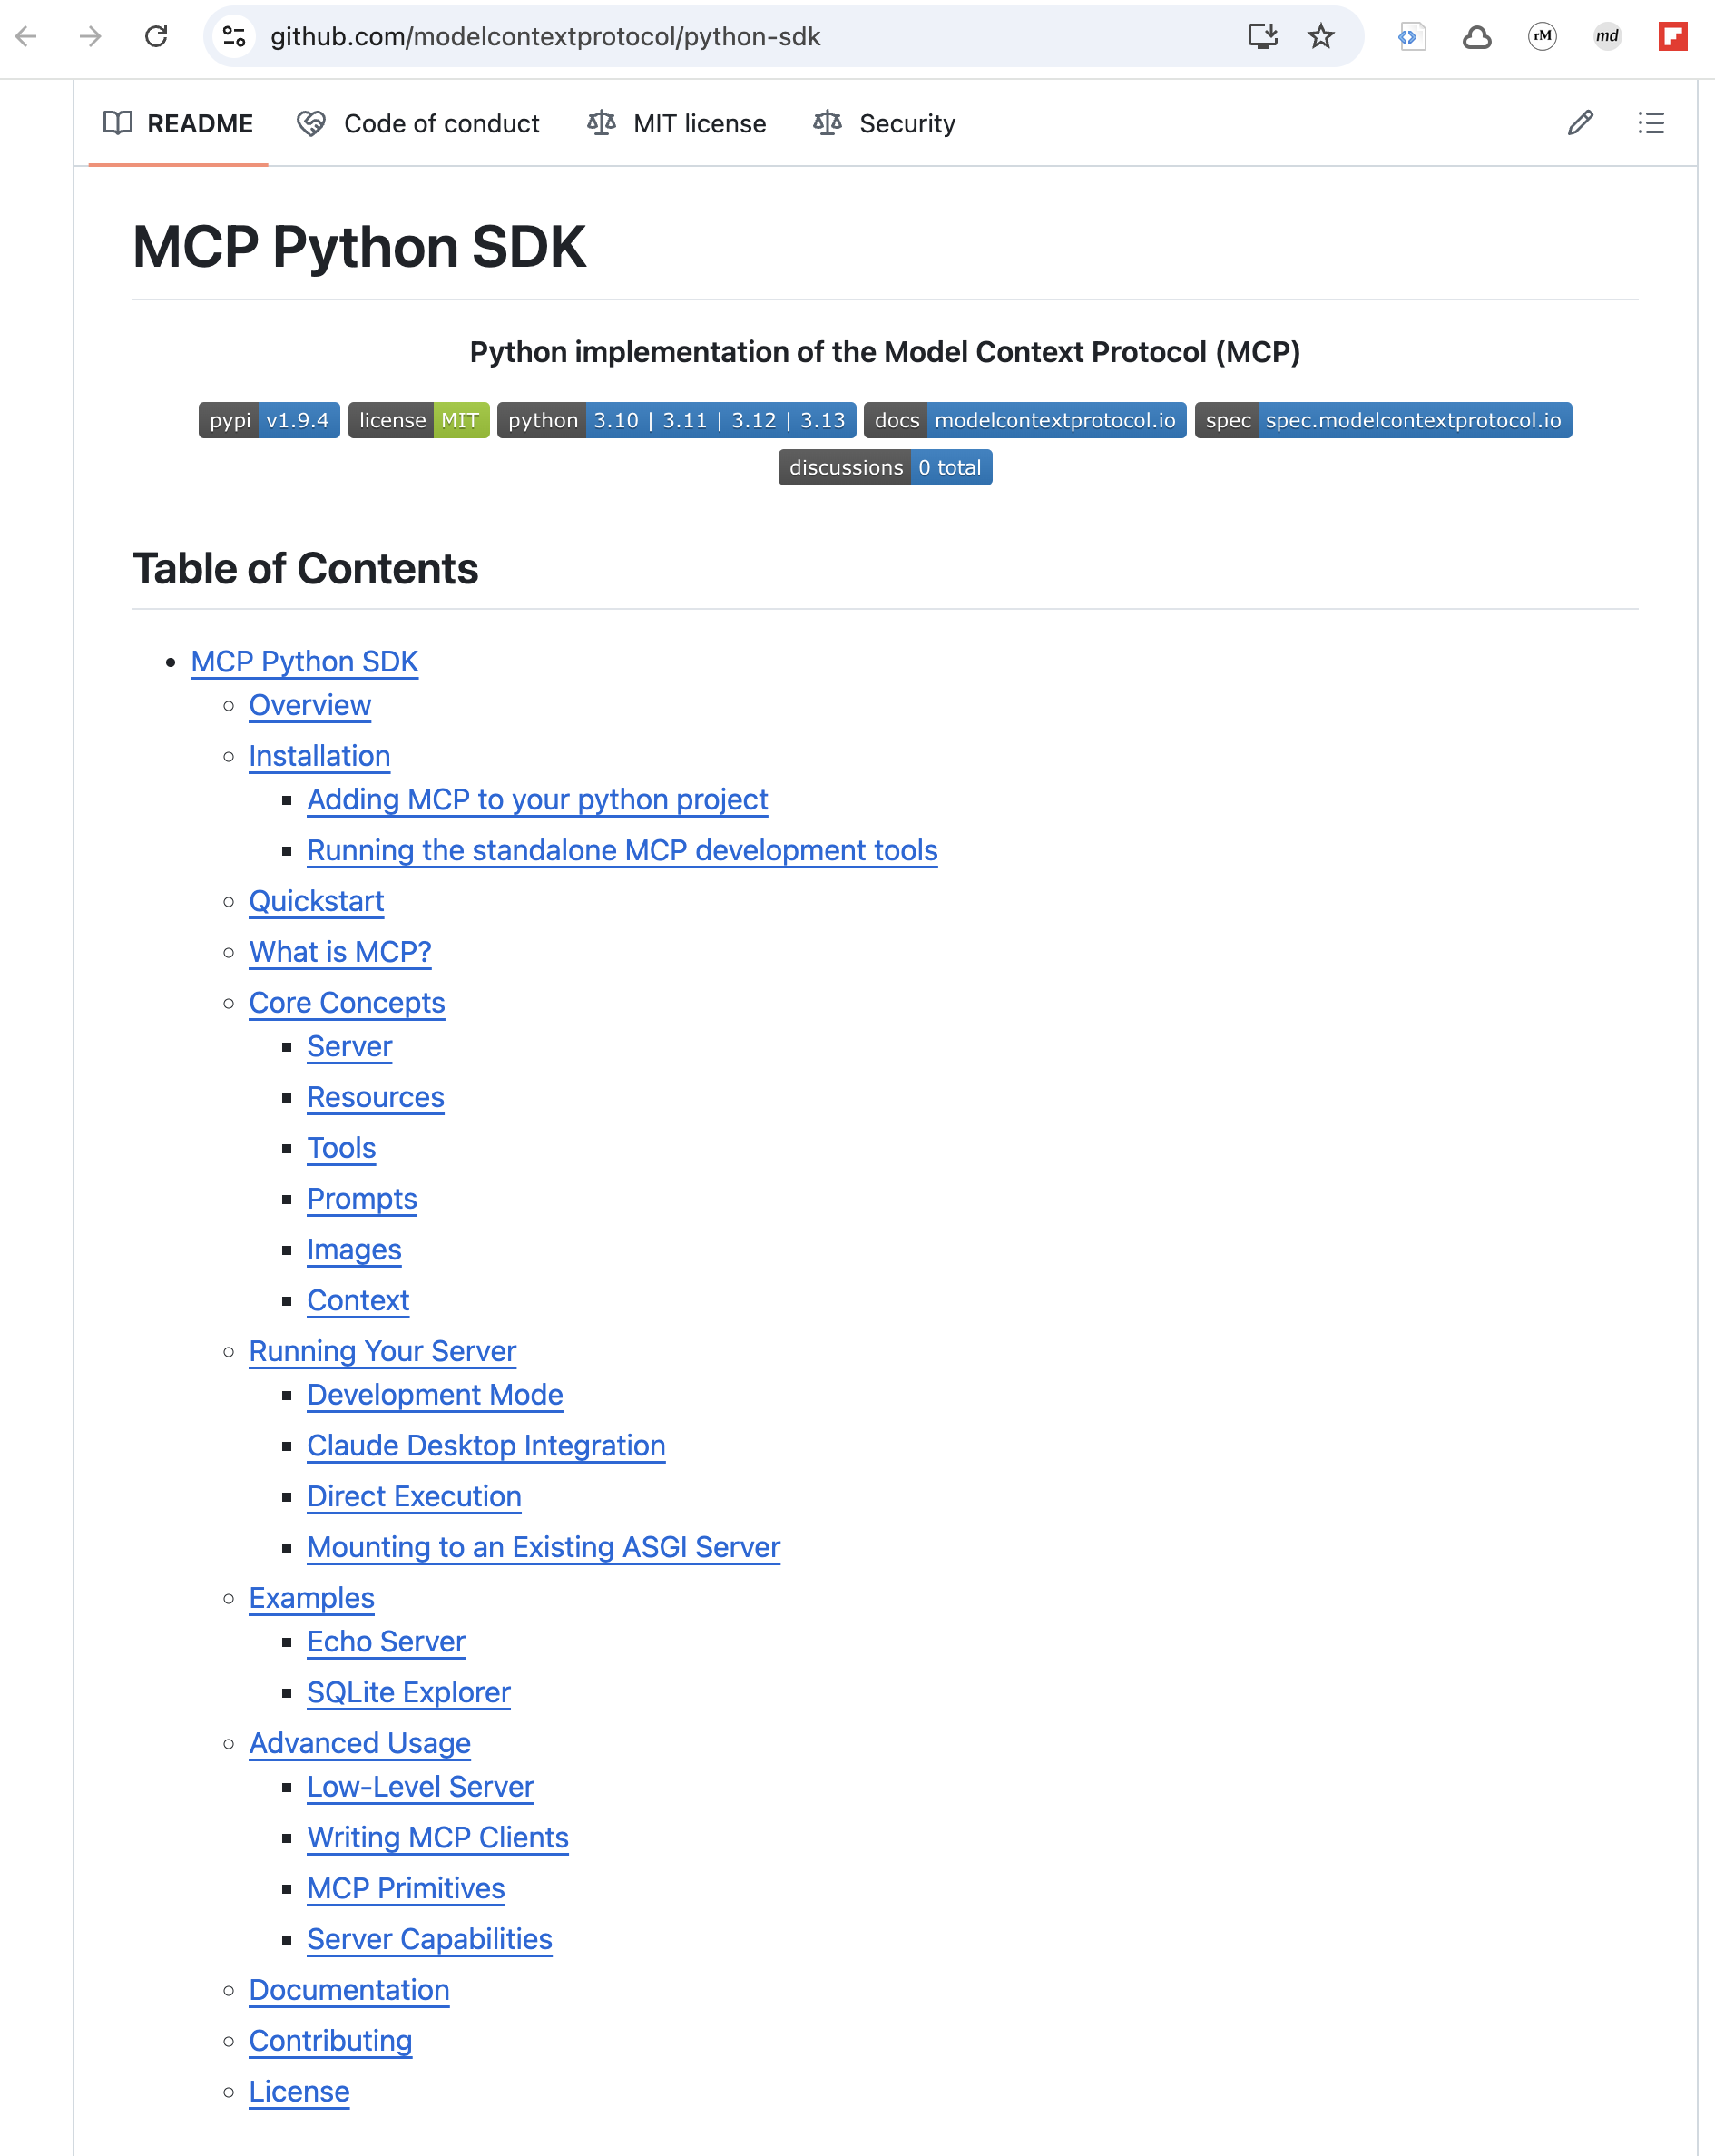
Basing on official MCP Python-SDK

Slide 32
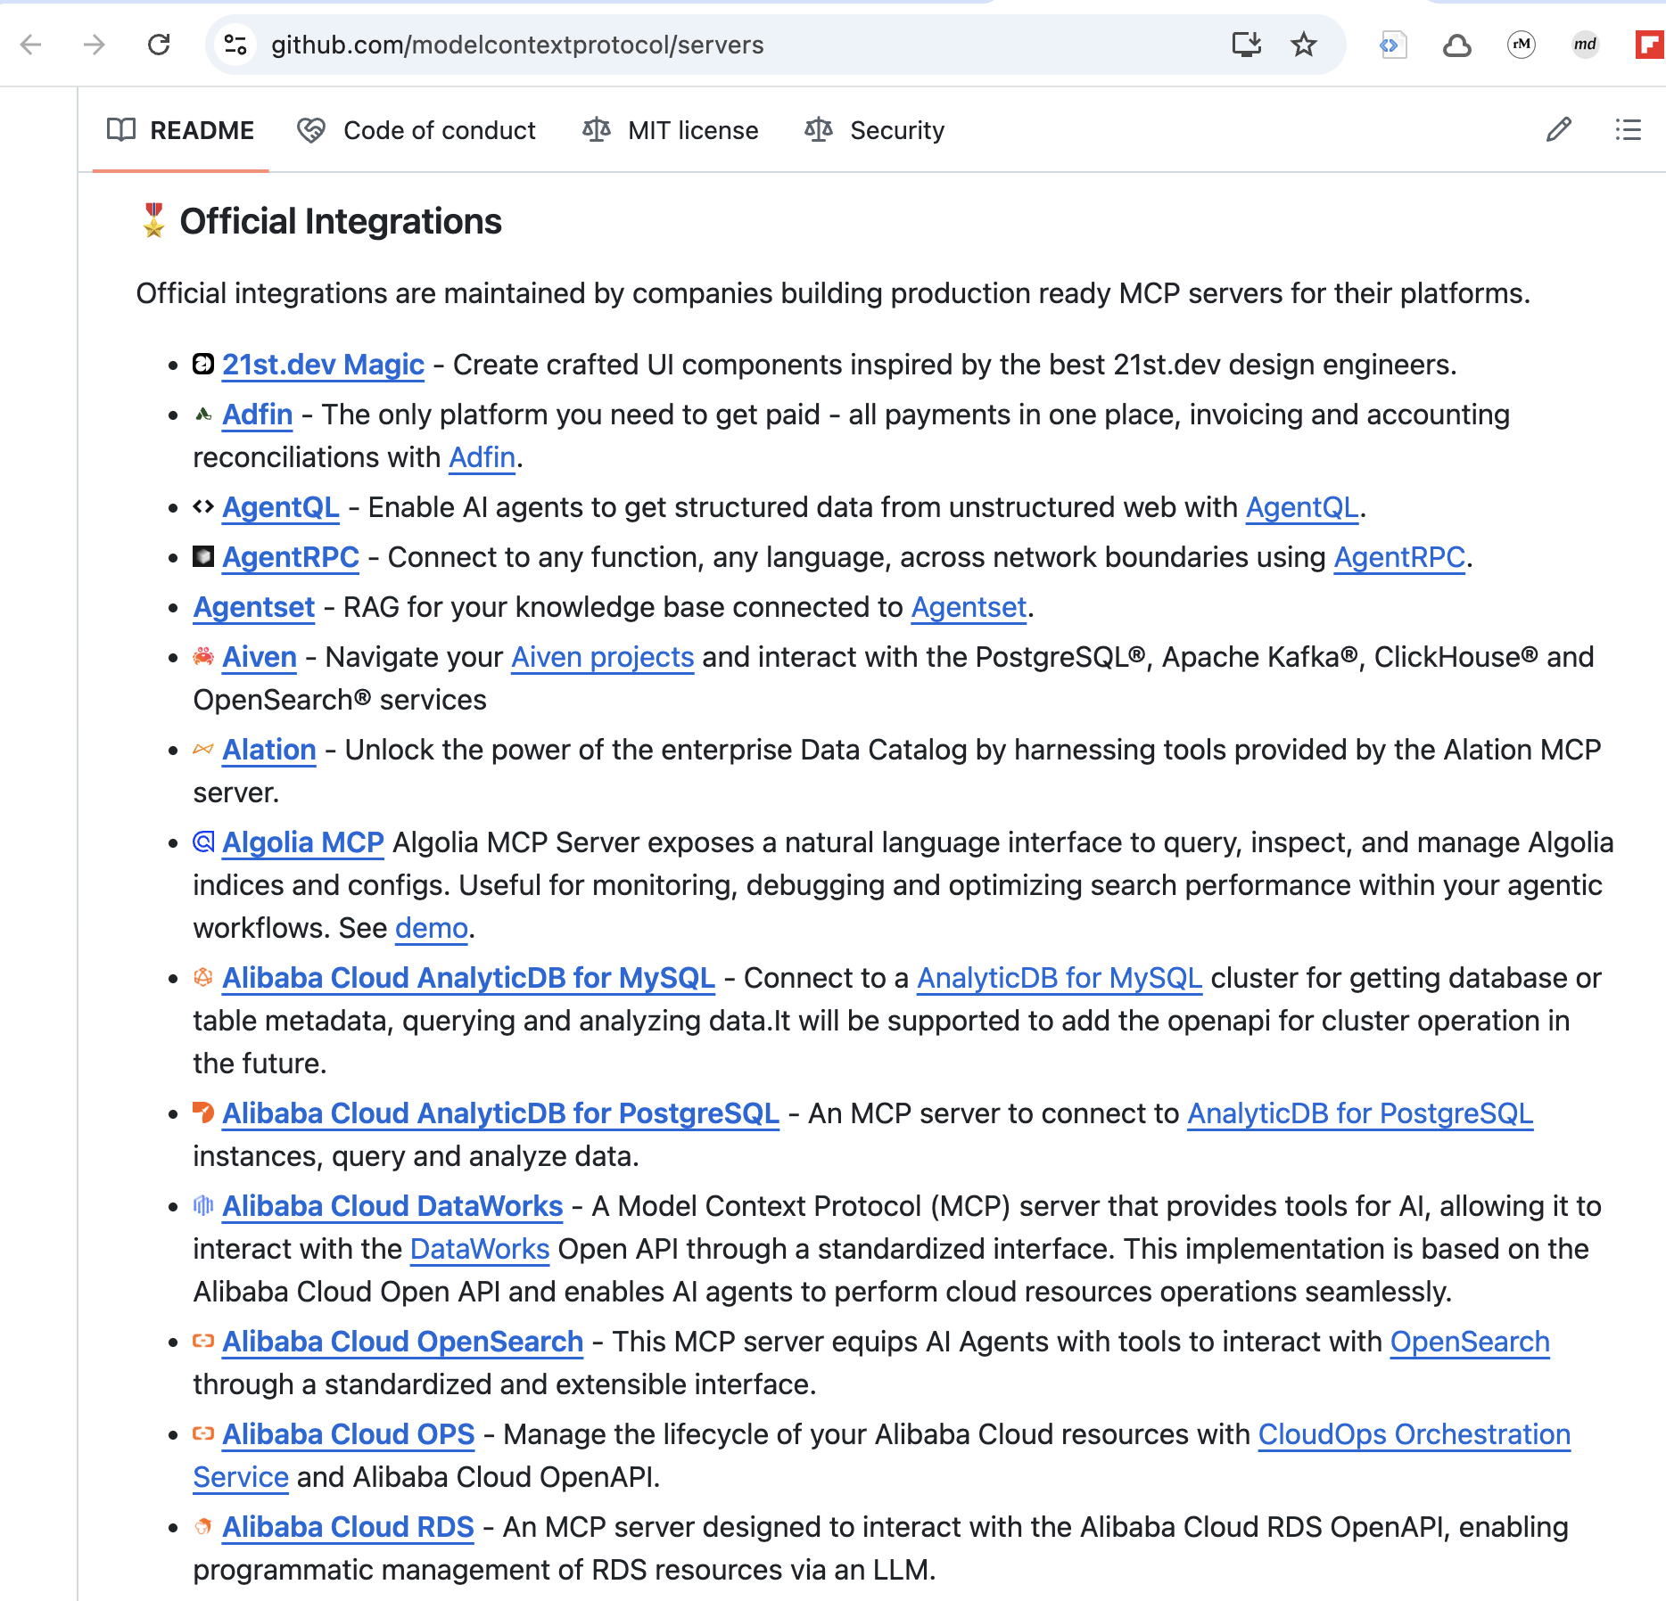
Official integratons

Slide 33
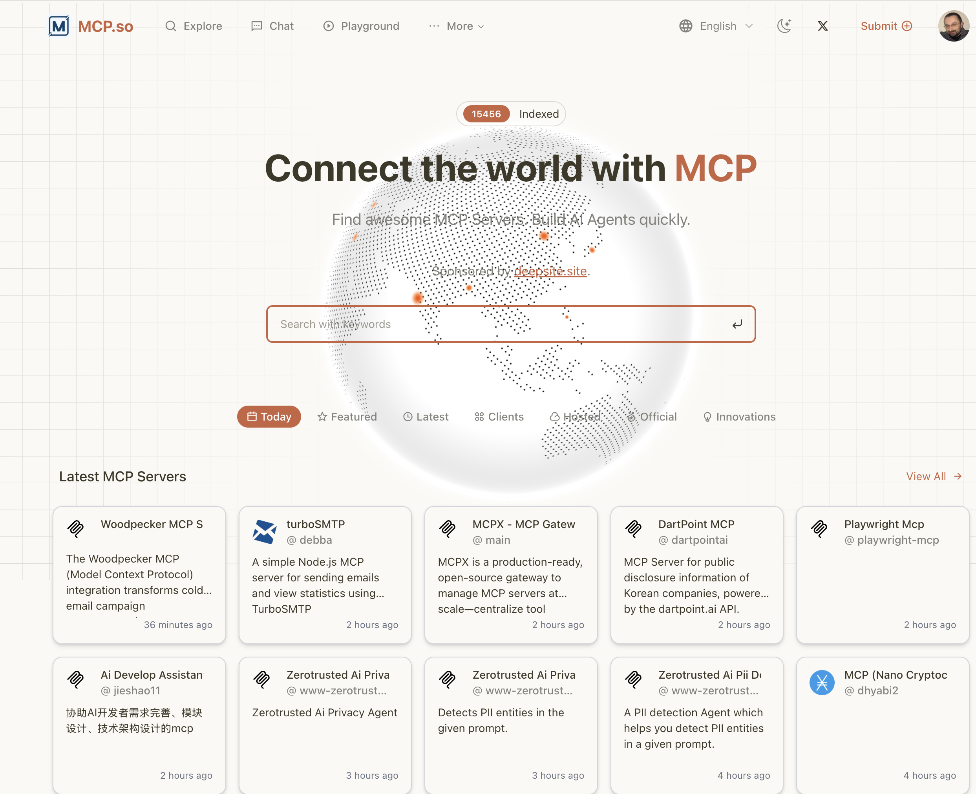
Use community-built MCP servers

Slide 34
How to run the MCP server?

Slide 35
Locally via stdio channel

Slide 36
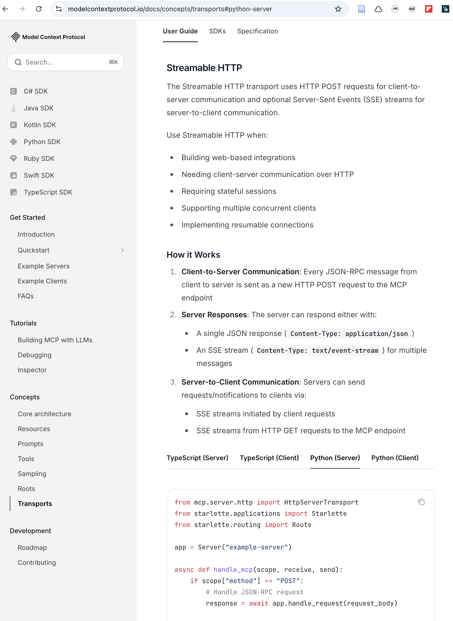
Remotely via Streamable HTTP channel

Slide 37
Docker

Slide 38
Security?

Slide 39
Useful tools

Slide 40
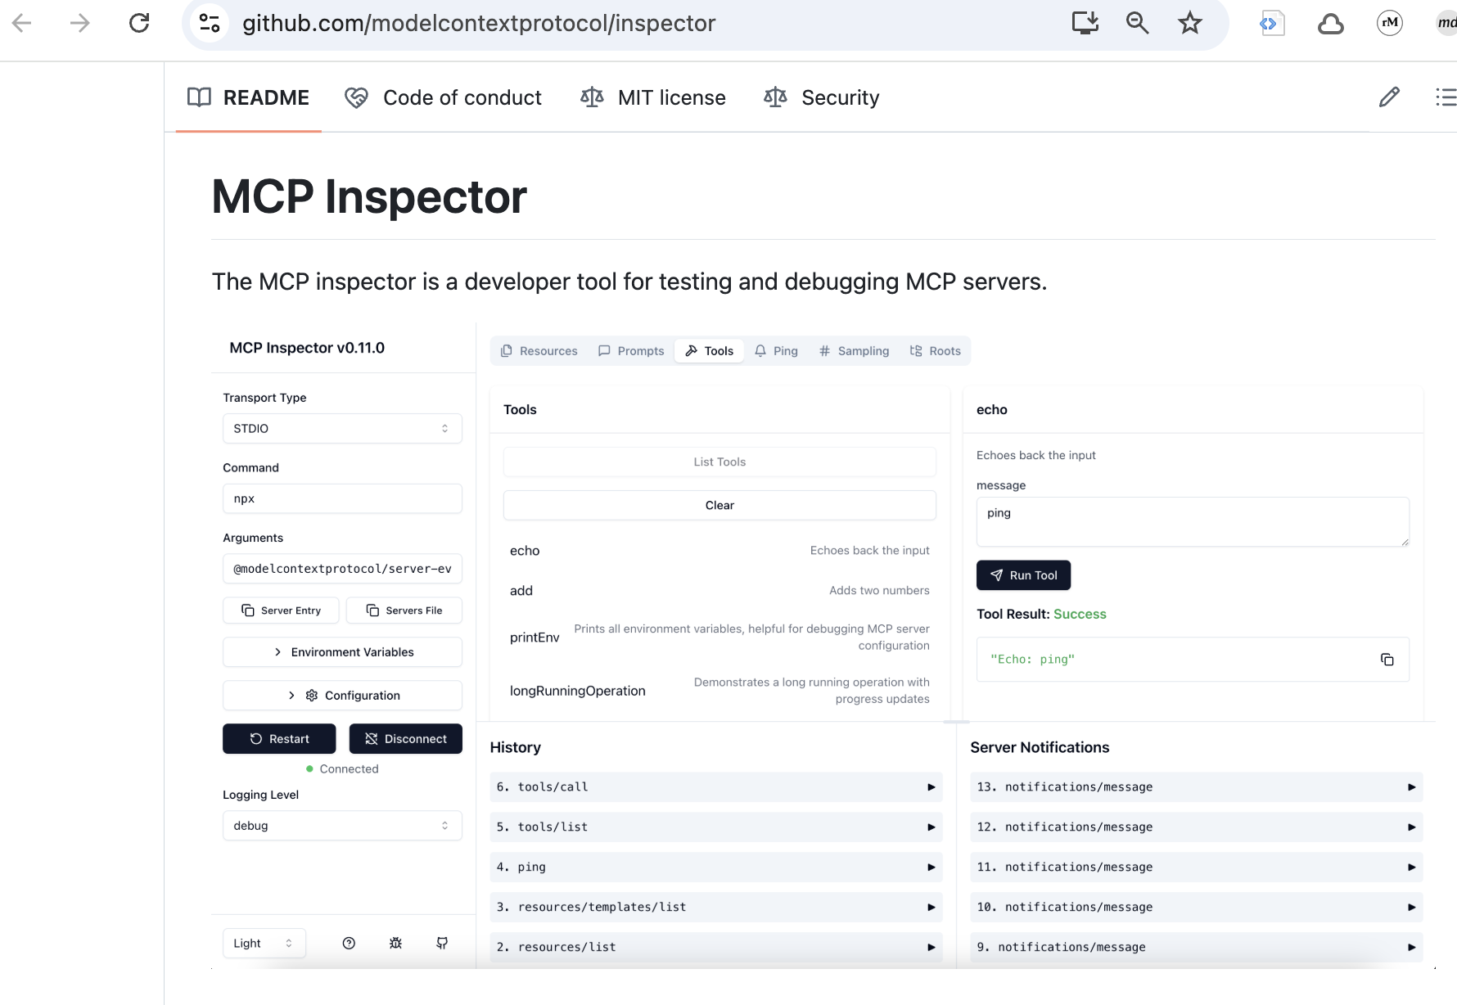
MCP inspector

Slide 41
Demo: llms.txt (docs)

Slide 42
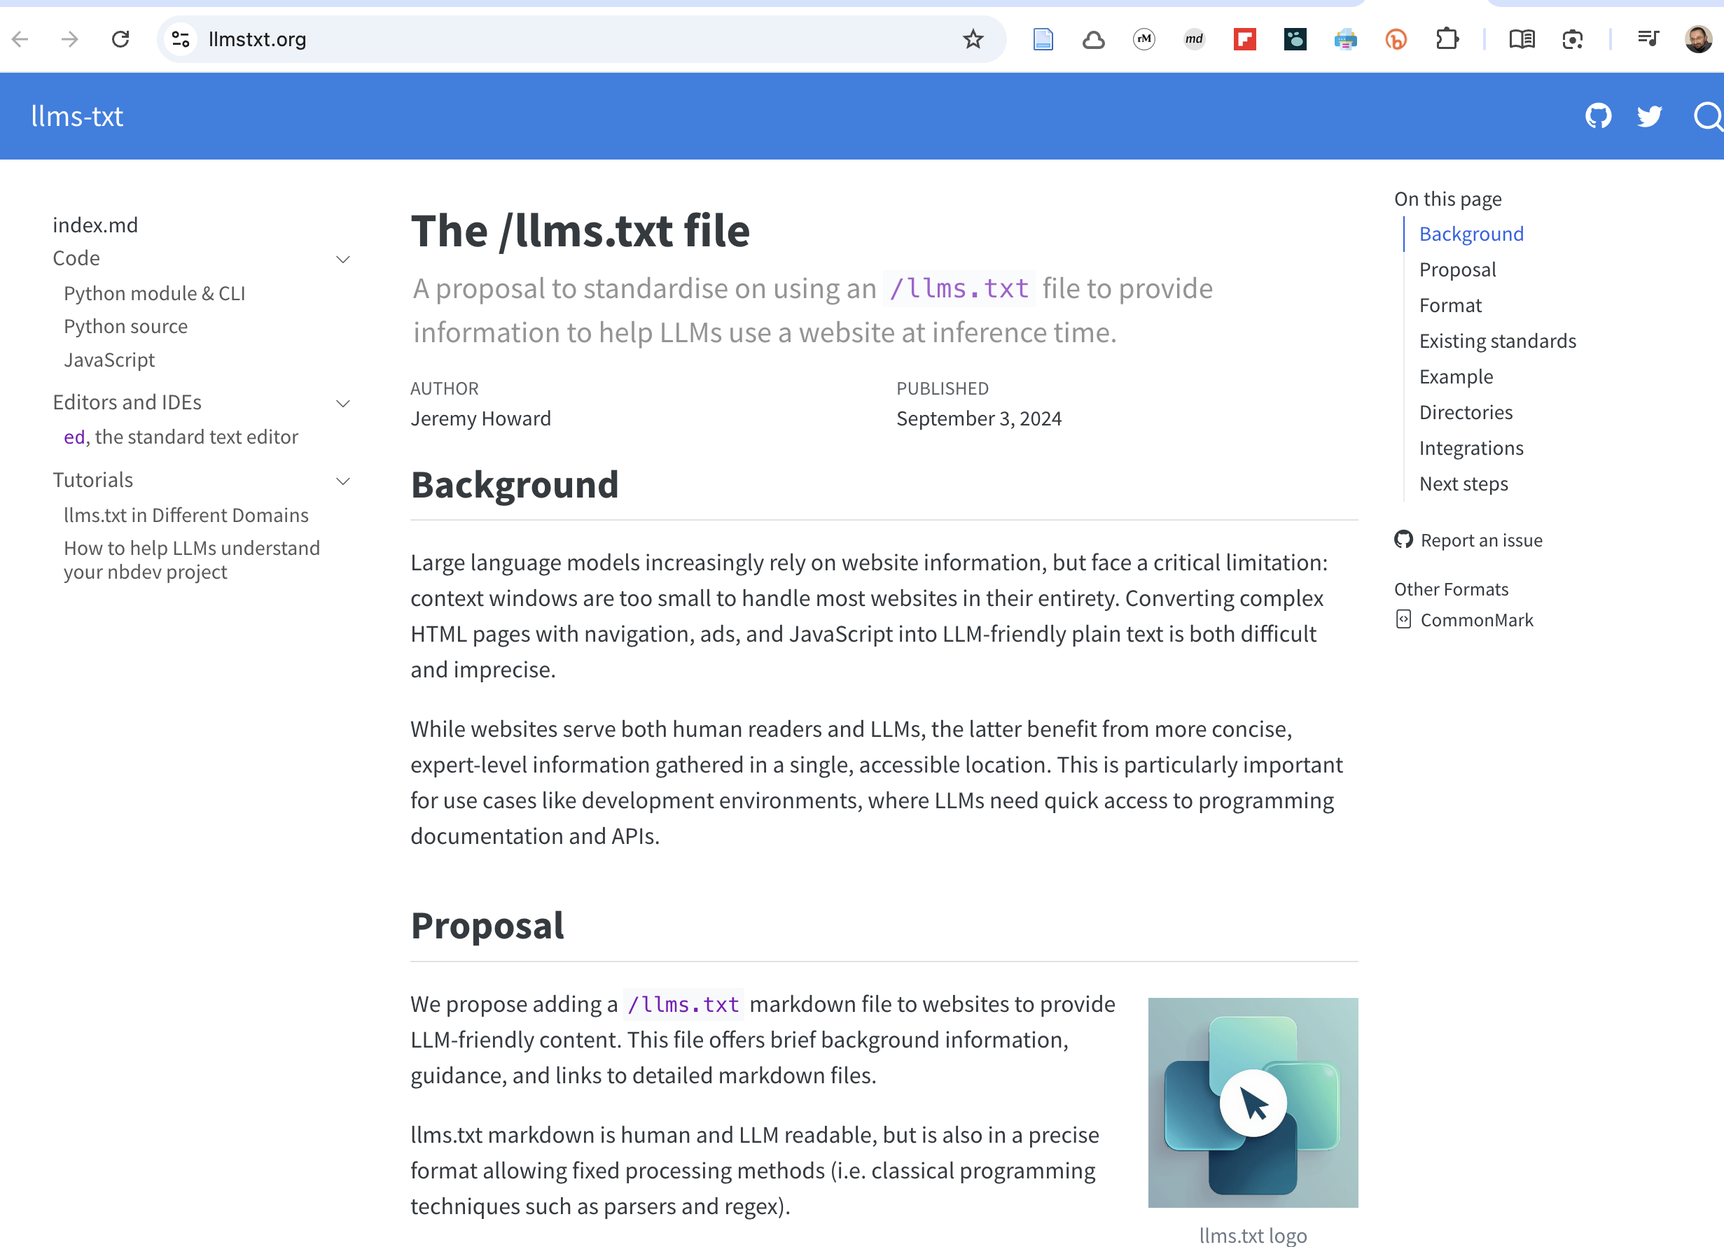
llms.txt

Slide 43
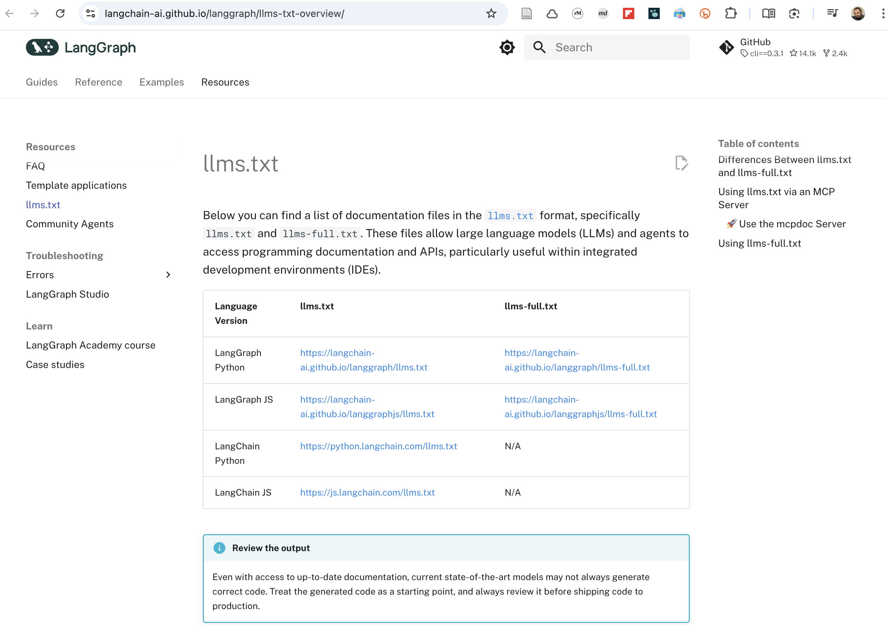
LangGraph llms.txt

Slide 44
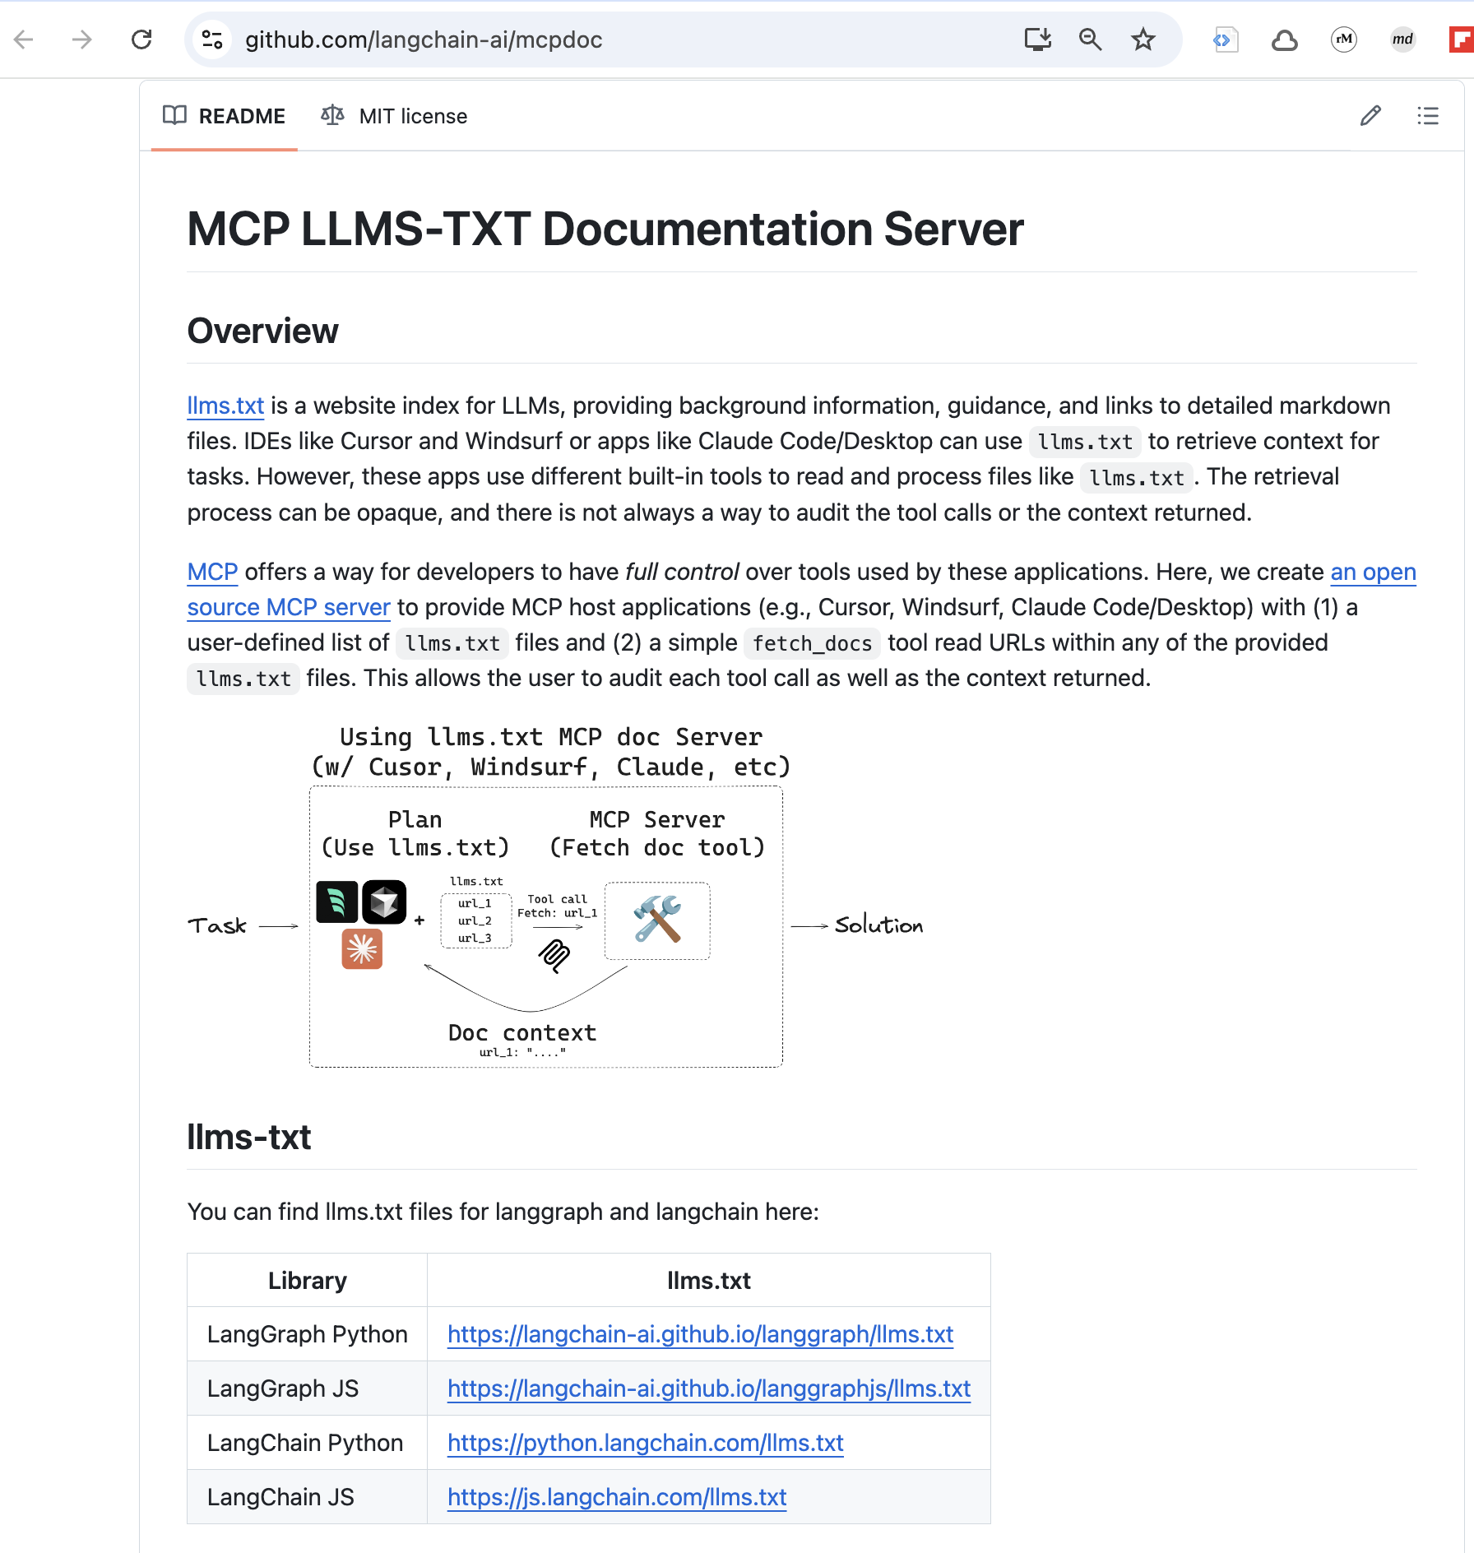
MCP llms-txt Documentation Server

Slide 45
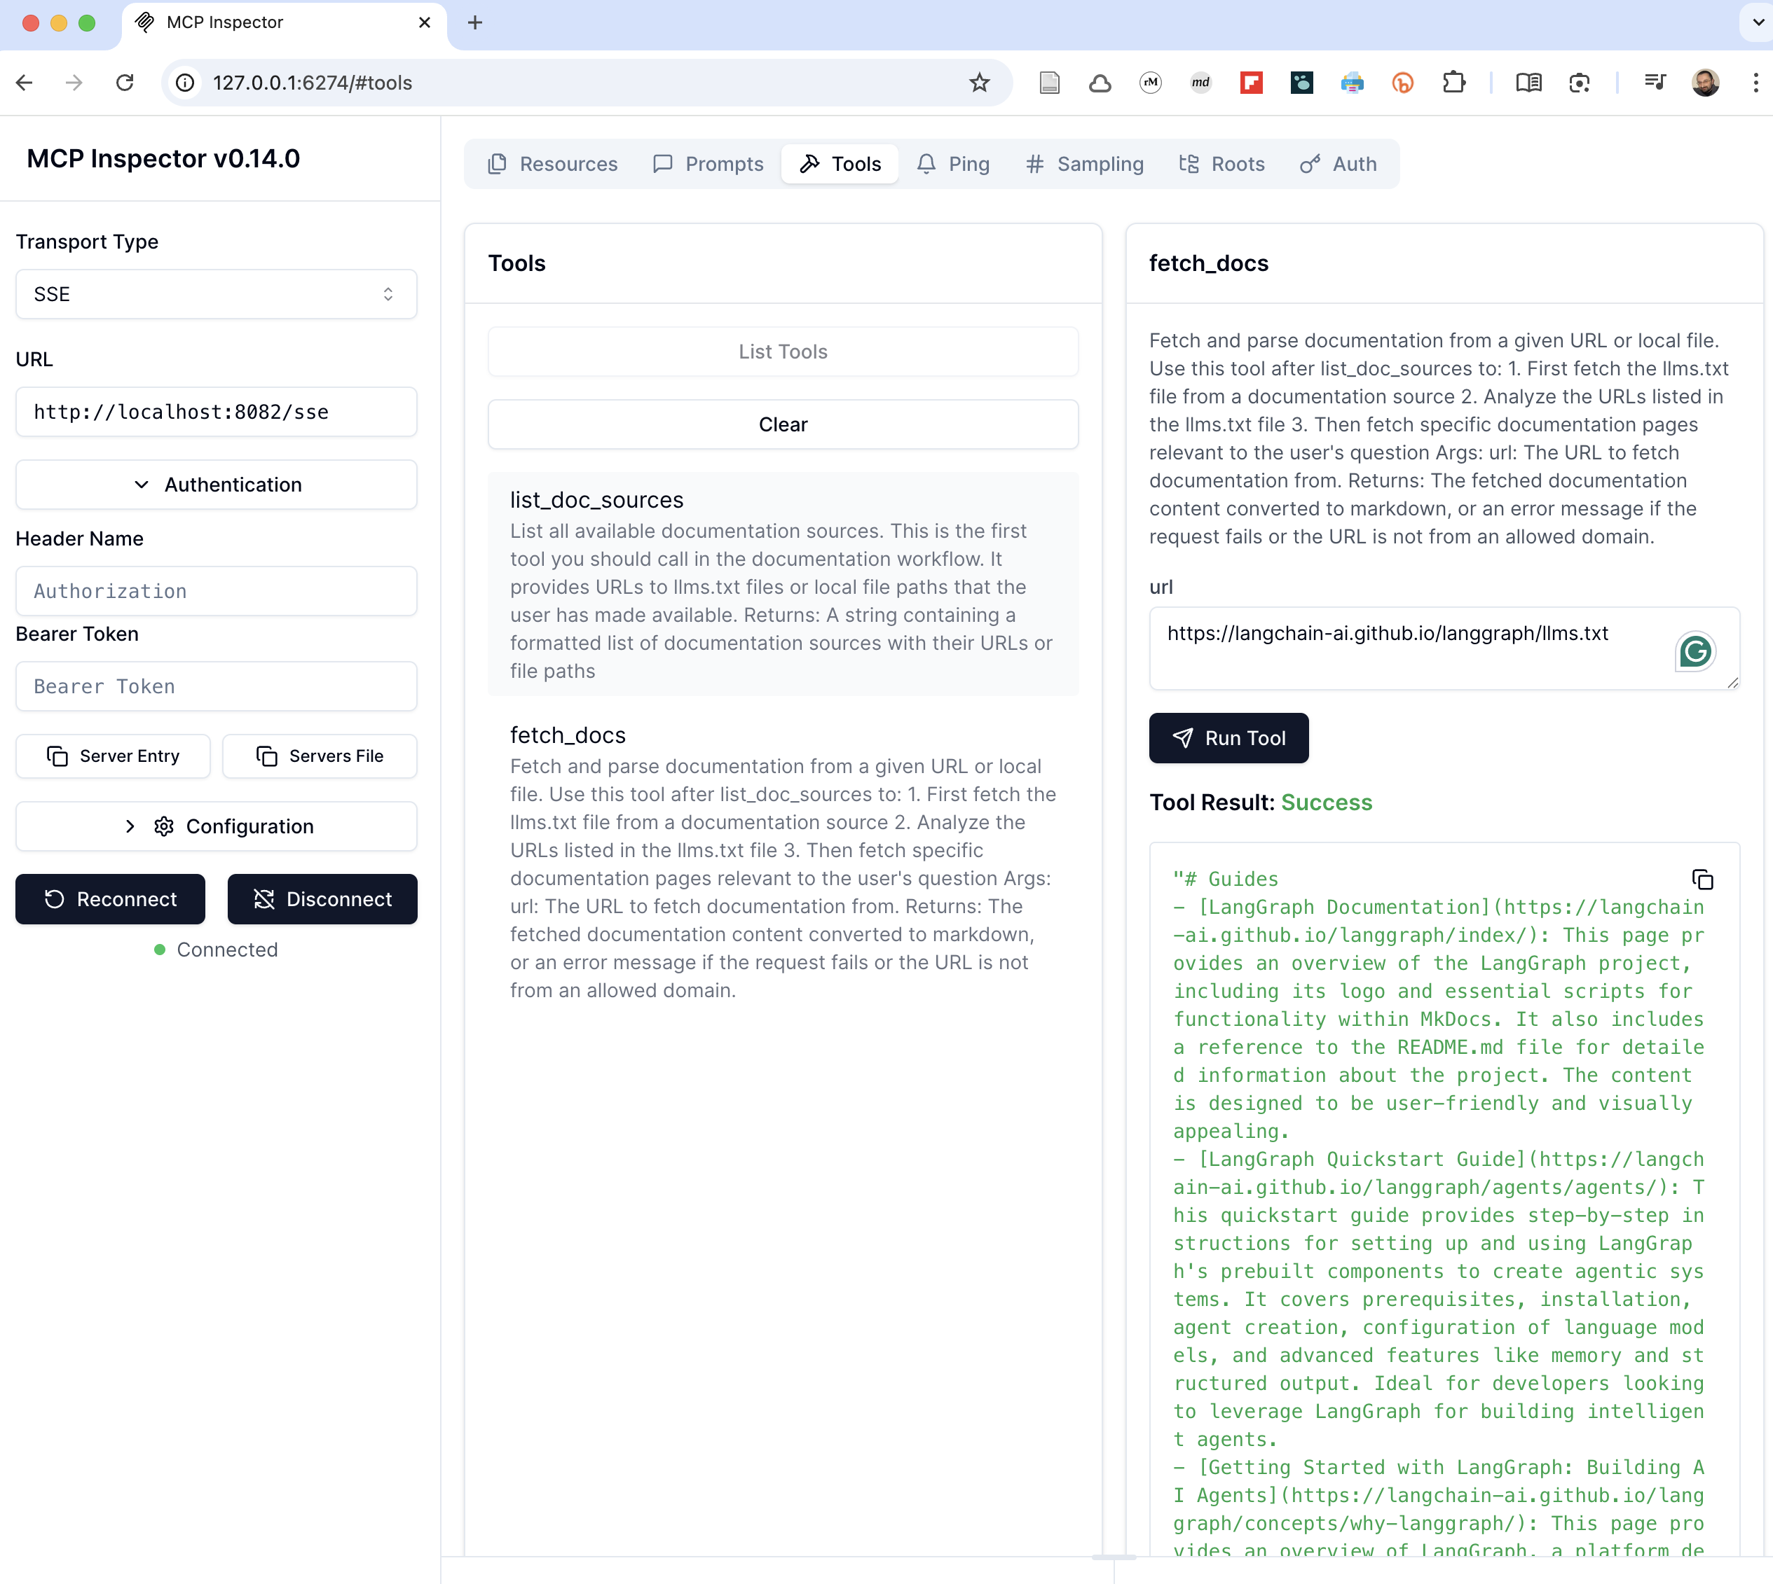
MCP Inspector

Slide 46
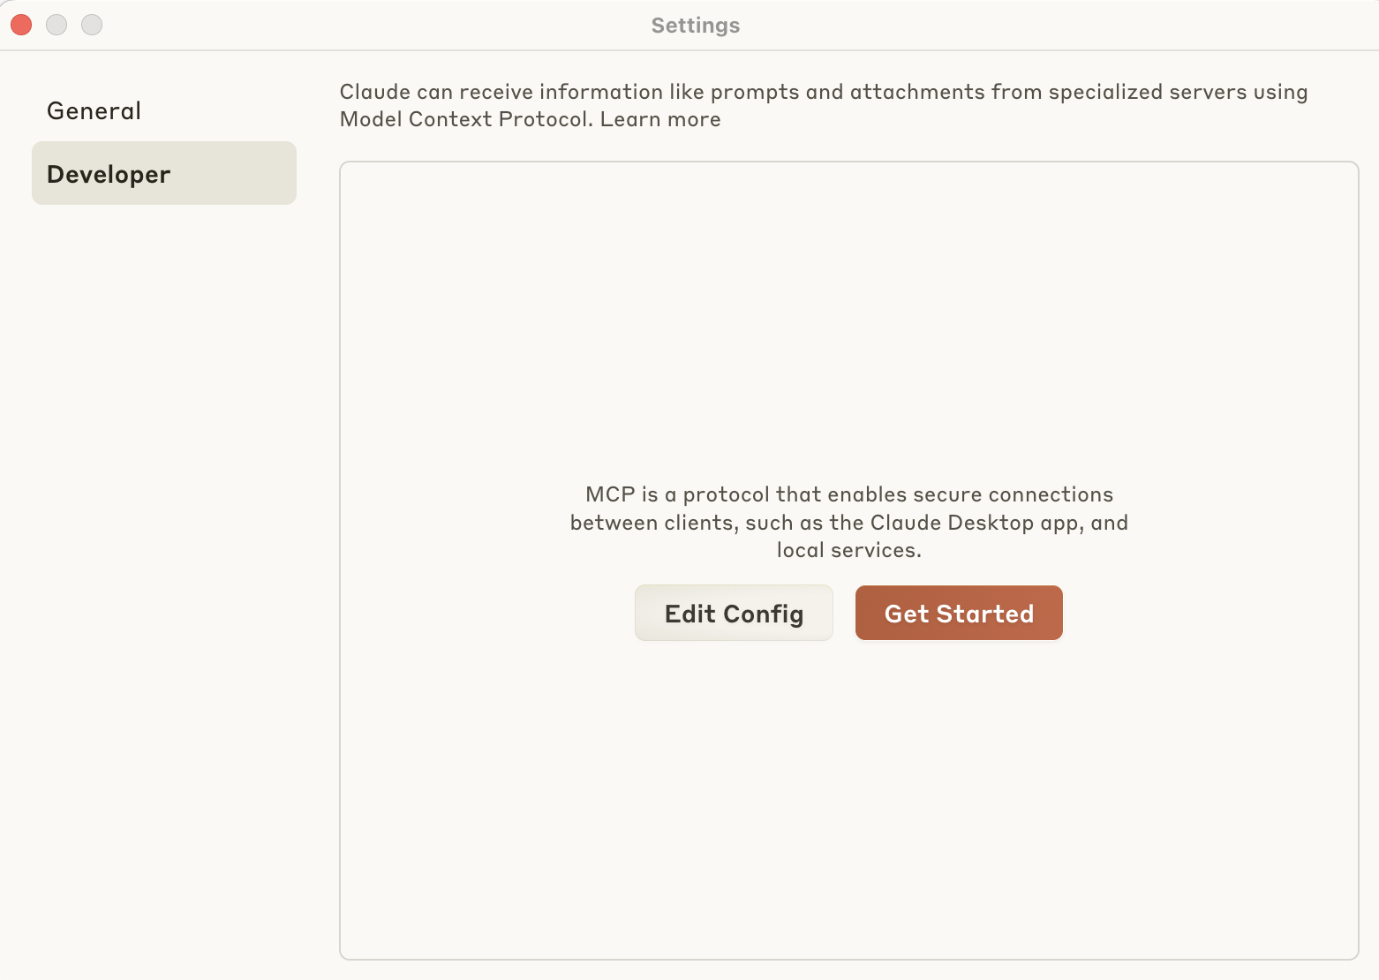
Claude integration

Slide 47
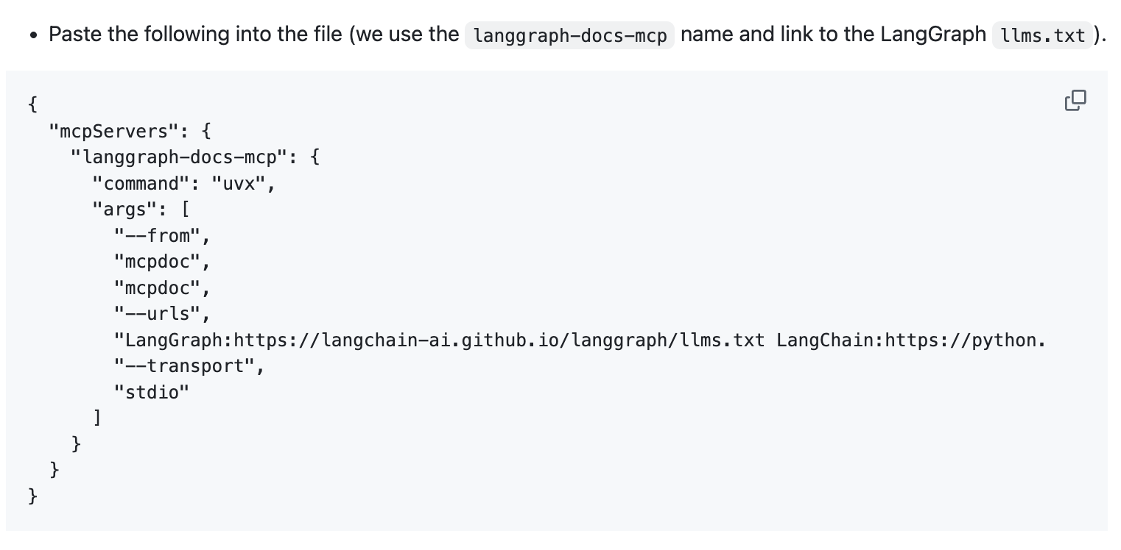
Claude integration

Slide 48
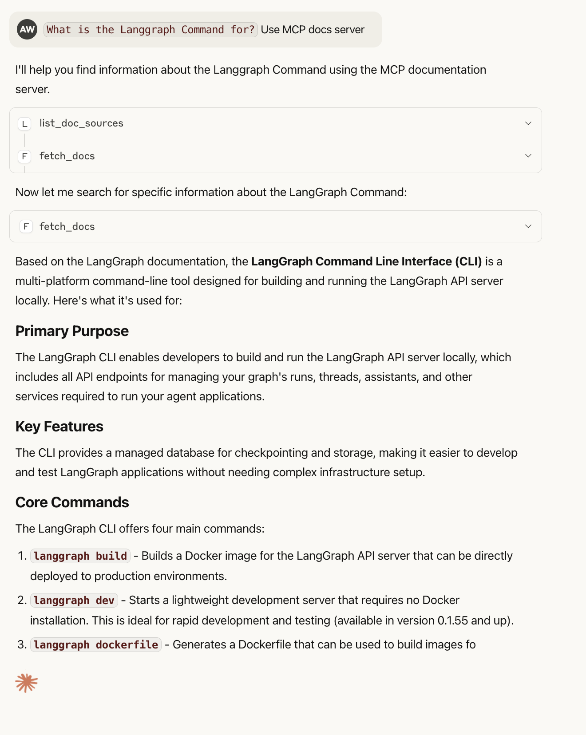
Claude integration

